Slide 1
Black-Box Attack and Transfer-Based Method
Kim Seung Hwan (overnap@khu.ac.kr)

Slide 2
Adversarial Attack (recall)
An image with appropriate perturbation to misclassify
Using these to fool the model is called an Adversarial attack

Slide 3
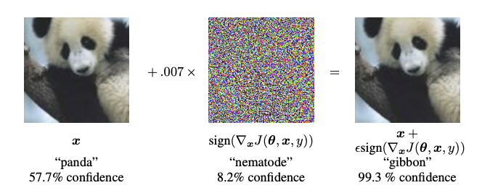
Adversarial Attack (recall)
One of the important properties of the examples is that the perturbation should NOT be identified by humans
So this is also how to make difficult samples
i.e., It can be viewed as a kind of argumentation

Slide 4
Black-box Attack
A kind of adversarial attack
Only knows the training set, the probability or logit
Or worse the predicted label

Slide 5
Black-box Attack
Of course, it is more challenging than white-box attack
It can be viewed, however, as a more realistic attack
Many commercial models only give probabilities or labels
If we make huge queries to the model, the service provider will be able to detect us easily
Therefore, in black-box attack, minimizing the number of queries becomes an important issue

Slide 6
Taxonomy of Black-box Attack
Gradient-based methods
Optimization-based methods
Transfer-based methods

Slide 7
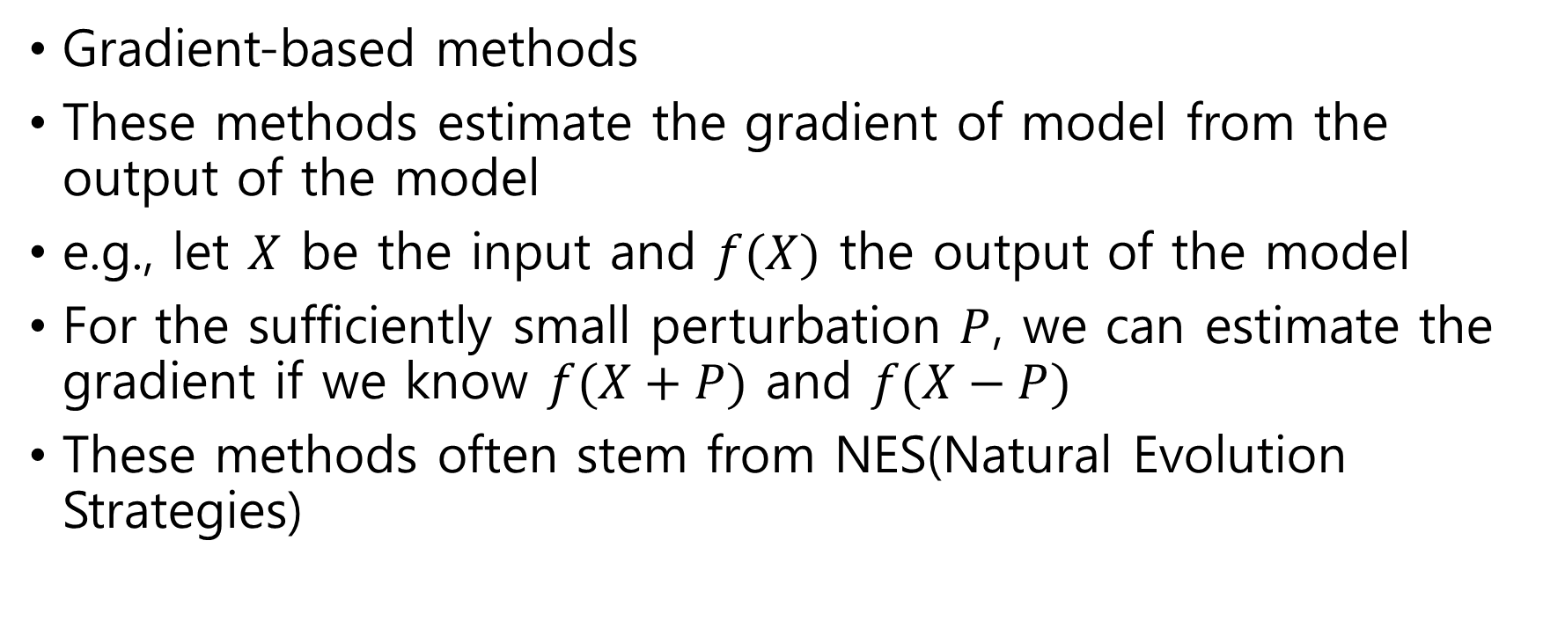
Taxonomy of Black-box Attack
Gradient-based methods
These methods estimate the gradient of model from the output of the model
e.g., let $X$ be the input and $f(X)$ the output of the model
For the sufficiently small perturbation $P$, we can estimate the gradient if we know $f(X+P)$ and $f(X−P)$
These methods often stem from NES(Natural Evolution Strategies)

Slide 8
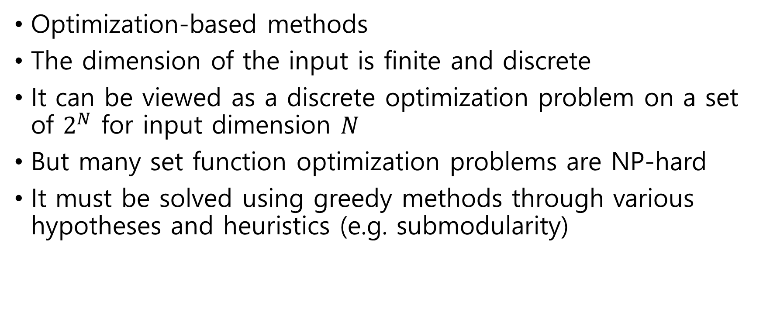
Taxonomy of Black-box Attack
Optimization-based methods
The dimension of the input is finite and discrete
It can be viewed as a discrete optimization problem on a set of $2^{N}$ for input dimension $N$
But many set function optimization problems are NP-hard
It must be solved using greedy methods through various hypotheses and heuristics (e.g. submodularity)

Slide 9
Taxonomy of Black-box Attack
Transfer-based methods
Train a substitute model, and generate adversarial examples with the replacement model
This is also the method I will talk today

Slide 10
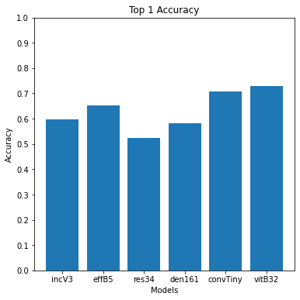
Adversarial Transferability (recall)
The property of adversarial examples that can be used in one model for another is called Adversarial Transferability
Use 10% subset of ImageNet 2012 valid set perturbated in pretrained ResNet50

Slide 11
Transfer-based Methods
Assume that this adversarial transferability works well
Just by training the substitute model well and using white-box methods, we can make adversarial examples
But also assume that:
We do not have the training set
We do not know the architecture of the target model
And we only know predicted labels, not probabilities

Slide 12
Transfer-based Methods
Get through this challenging situation with the method introduced in “Practical Black-Box Attacks against Machine Learning” (Papernot et al.)
And look at some interesting results about adversarial transferability introduced in the paper

Slide 13
Substitute Training
Authors introduce attack in five stages:
(1) Initial Collection
(2) Architecture Selection
Substitute Training:
(3) Labeling
(4) Training
(5) Augmentation

Slide 14
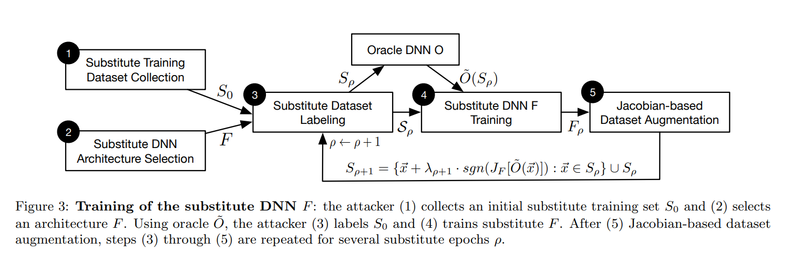
Substitute Training
Substitute training

Slide 15
Jacobian-based Augmentation
Assume that we have only 10 images as initial data
Surely we need more images to train the model
Authors argue that it is natural to need more data on where the output of the model vary

Slide 16



Jacobian-based Augmentation
So for the input , Jacobian , and the output ,
Authors propose Jacobian-based heuristic augmentation
This aims to mimic the decision boundary of the target model, not to improve the accuracy of the substitute

Slide 17
FGSM
After the substitute is well-trained, white-box methods such as FGSM are used
It produces good results (e.g. more than 90% error for MNIST)

Slide 18

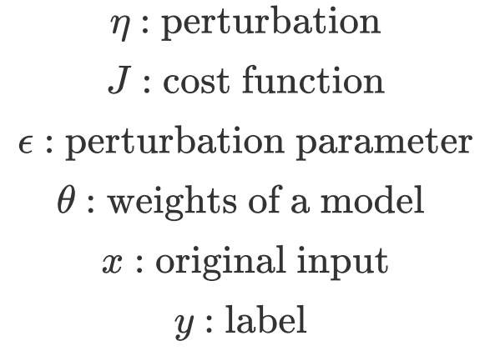
FGSM (recall)
Assume that the cost function is linear around the current theta
The perturbation can be optimized in the same way in nonlinear model

Slide 19
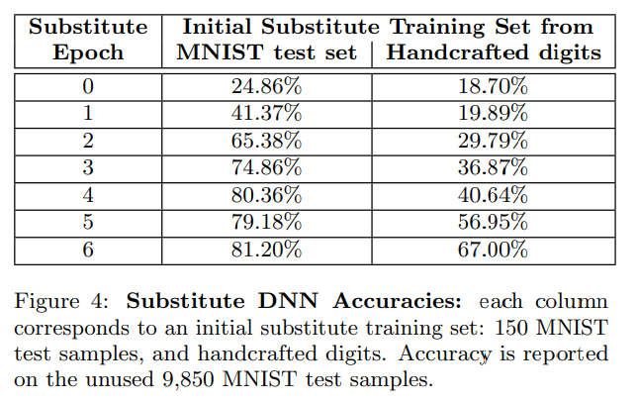

Results In The Paper 1
The distribution from which you collect the initial data does not matter much

Slide 20
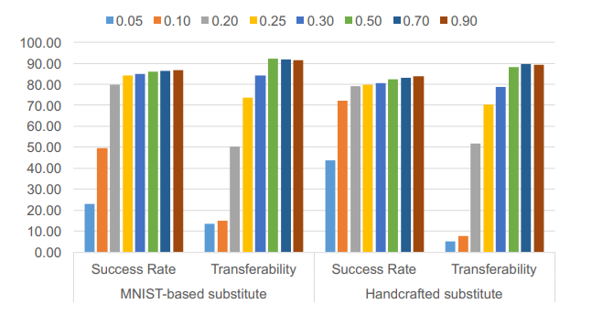
Results In The Paper 1
The distribution from which you collect the initial data does not matter much
Transferability also works well

Slide 21
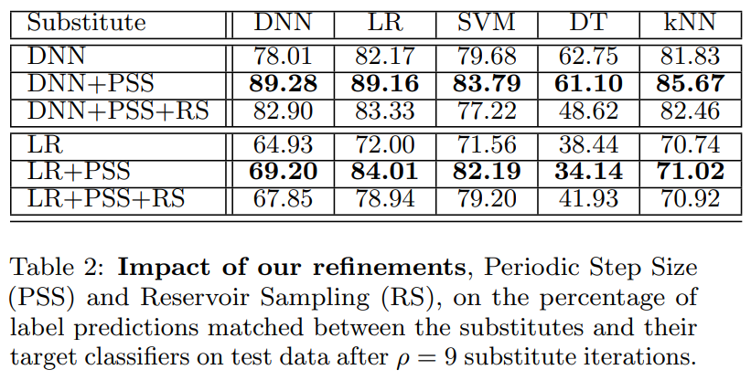
Results In The Paper 2
The architecture of the substitute does not matter much

Slide 22
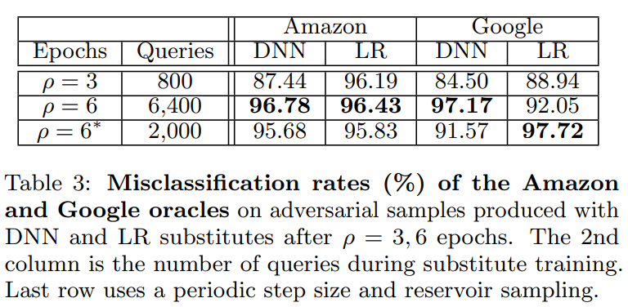
Results In The Paper 2
The architecture of the substitute does not matter much

Slide 23
Discussion 1
The architecture of the substitute does not matter much
This means that the attack are not model dependent
I think that the vulnerability of DNN models is due to the dataset itself, contrary to the impression that it is a problem with the structure of the model

Slide 24
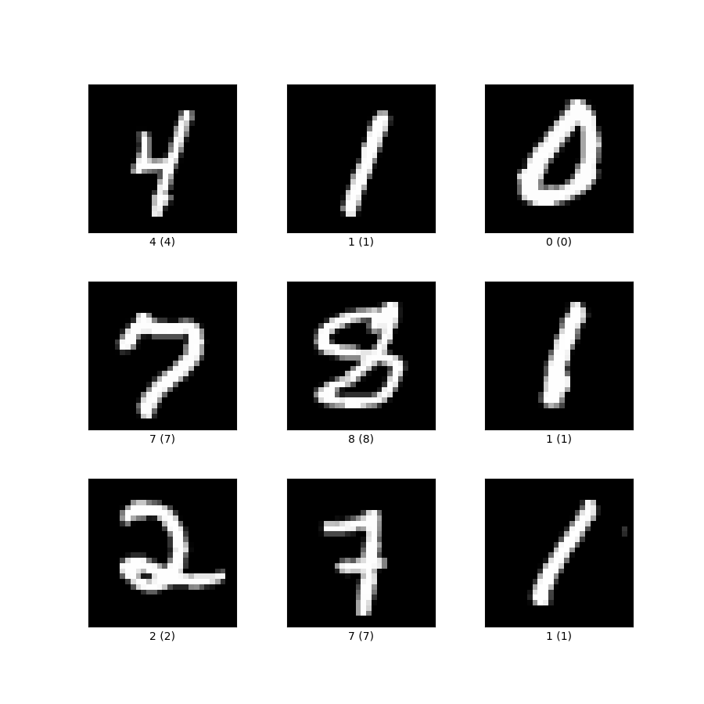
Discussion 2
But then why are the handcrafted MNIST experiment results so good?
This is obviously a different distribution from original MNIST
This seems to be possible because the dimensions of MNIST are sufficiently small

Slide 25
Discussion 3
I think the substitute will need more samples in the opposite direction of the Jacobian – the near of the decision boundary
However, when trained with augmented samples in the direction of the Jacobian, good results are obtained
This seems to be due to the very small number of initial data (only 10-100 samples)

Slide 26
Discussion 3
Authors explain that switching the lambda(a Jacobian multiplied constant) between + and - yields better results, because it causes an out of distribution when only + are used
I think this is because, as mentioned earlier, the data in opposite direction is the data near the decision boundary

Slide 27
Discussion 4
It seems that a transfer-based targeted attack is possible if the targeted attack method is used instead of FGSM
But it is known that it does not transfer well
Why?

Slide 28
Conclusion
Only the output label of the target model can generate a substitute model
Proposed a Jacobian-based augmentation for the training for the substitute
The substitute makes it easy to create adversarial examples
It has been shown that a black-box attack is feasible for actual services (e.g. Amazon and Google)

Slide 29
Further Study
Transfer-based targeted attack
Clearly understand the role of Jacobian-based augment
How to effectively decrease the number of queries to the target model
Other types of black-box attacks (i.e. Gradient-based and Optimization-based methods)

Slide 30
Thank You For Listening
Kim Seung Hwan (overnap@khu.ac.kr)

